Slide 1

Presented by: Priyanka saraf

Slide 2
Github
Coding is very interesting field. While learning coding, creating projects we lack the supports and mentor to guide; Github is code hosting platform which uses git for version control and collaboration. It enable you and others to work on on project together from anywhere.

Slide 3
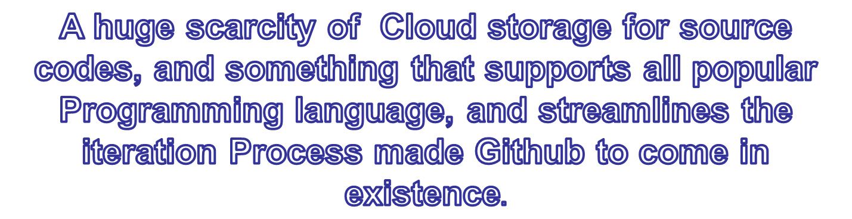

Slide 4
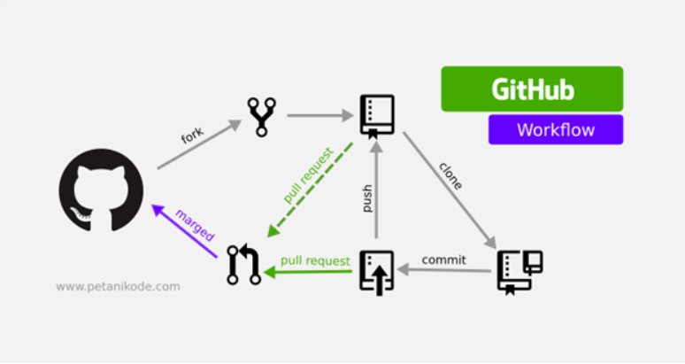
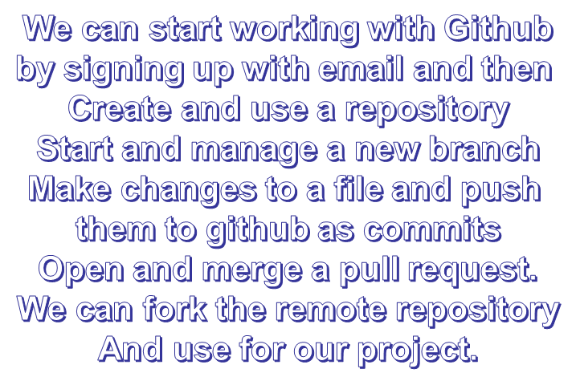
Workflow of Github

Slide 5
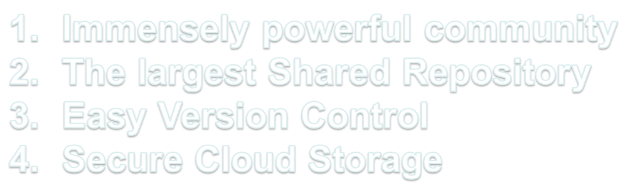
Commercial advantage of Github

Slide 6


